Slide 1

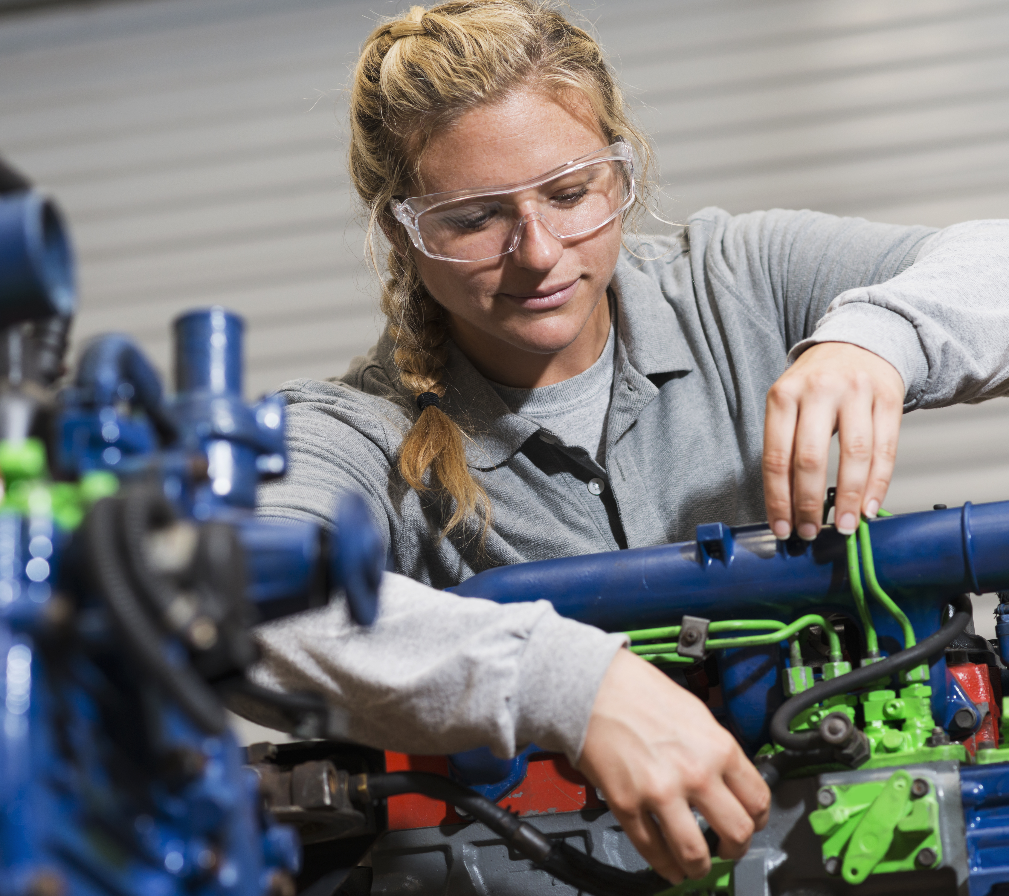
SESSION 5
Let’s Motorize

Slide 2
Guiding Questions
What products are inside each package?
How do packages get transported in an out of your community?
Outcomes
The team will determine what products are transported in the cargo containers.
The team will build and code the motor and hub build and then change the program to sort blue cargo.
Can you motorize the sorting center?
How do you change the program so that the blue cargo is sorted?
Notes:
Each session has Guiding Questions that can be shared to frame the session.​
Session Tips
Ask the team what the difference is between products, packages, and cargo. Packages can contain one product (like bananas) or different products. Cargo is made up of many packages.
Have the team research products that are created or transported throughout their community.
The team will need Book 2 and Bag 3 located in the Explore set.
The team will determine how to change motor direction.
It would be beneficial to cover how different motor directions turn the sorting mechanism to the right or left.

Slide 3
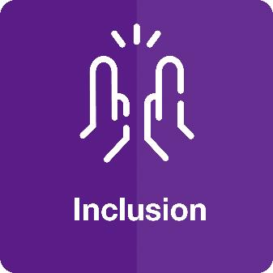


Introduction – Be Inclusive
Examples of Inclusion
Ask the students to provide examples of Inclusion and record them here
Example of Inclusion
Example of Inclusion
We respected each other and embraced our differences.
Extension
Notes:
Introduction
Be Inclusive
(10 minutes)
Read the definition for inclusion to the team. (see page 5)
Talk about what inclusion is. Have the team provide examples of this Core Value.
Extension: Have everyone draw a picture of an example of inclusion on the Core Values page in their Engineering Notebook.

Slide 4
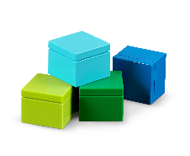


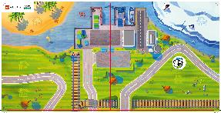

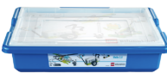
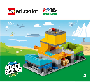
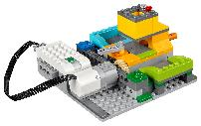
Task 1
You need…
What cargo is transported in and out of your community?
What could be inside each cargo package?
Notes:
Tasks (20 minutes)
Read over Ruby and Jacob’s questions.
Get thinking!
Write down your ideas in the table.
Explore different areas on the mat where cargo packages are transported.
Choose and list the different starting points and destinations in the table.

Slide 5
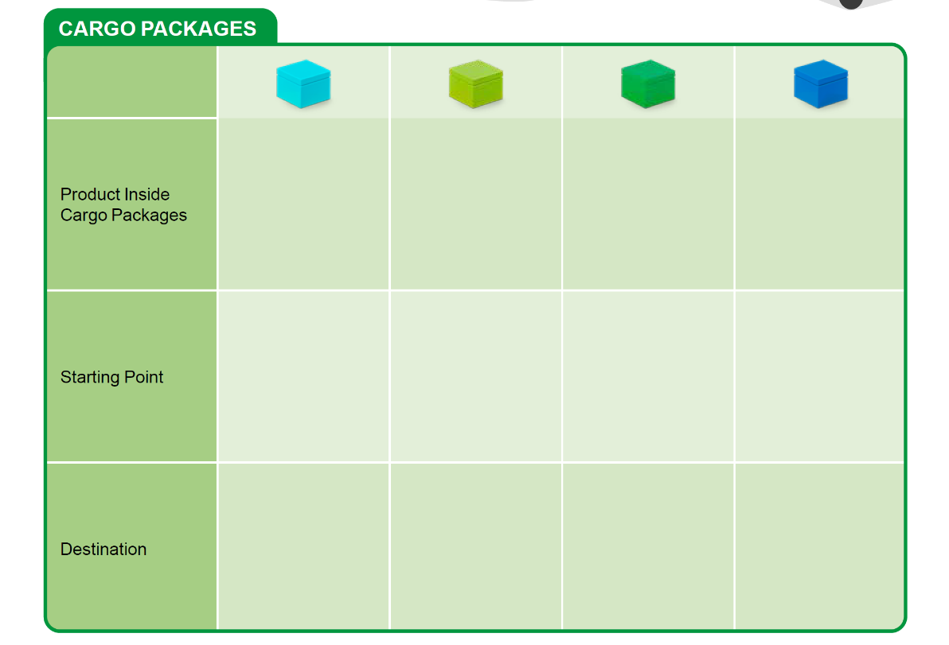
Task 1
Notes:
Tasks (20 minutes)
Read over Ruby and Jacob’s questions.
Get thinking!
Write down your ideas in the table.
Explore different areas on the mat where cargo packages are transported.
Choose and list the different starting points and destinations in the table.

Slide 6

Task 1
Explore different areas on the mat where cargo packages are transported.
Choose and list the different starting points and destinations in the table.
Notes:
Tasks (20 minutes)
Read over Ruby and Jacob’s questions.
Get thinking!
Write down your ideas in the table.
Explore different areas on the mat where cargo packages are transported.
Choose and list the different starting points and destinations in the table.

Slide 7

Task 2
Follow the building instructions in Book 2 to make the motor and hub build.
Connect the motor and hub build to the sorting center.
Notes:
Tasks (20 minutes)
Follow the building instructions in Book 2 to make the motor and hub build.
Connect the motor and hub build to the sorting center.
Open the WeDo 2.0 app.
Re-create the program provided in Book 2. Try it out!
How is blue cargo sorted into the blue bin on the sorting center? Brainstorm your ideas.
Say what you would change in the program in the space below.
Play your program to sort the blue cargo.

Slide 8
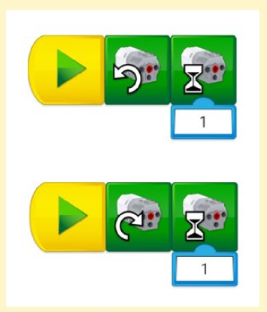
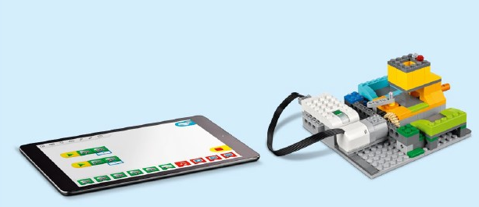
Task 2
Open the WeDo 2.0 app.
Re-create the program provided in Book 2. Try it out!
Notes:
Tasks (20 minutes)
Follow the building instructions in Book 2 to make the motor and hub build.
Connect the motor and hub build to the sorting center.
Open the WeDo 2.0 app.
Re-create the program provided in Book 2. Try it out!
How is blue cargo sorted into the blue bin on the sorting center? Brainstorm your ideas.
Say what you would change in the program in the space below.
Play your program to sort the blue cargo.

Slide 9
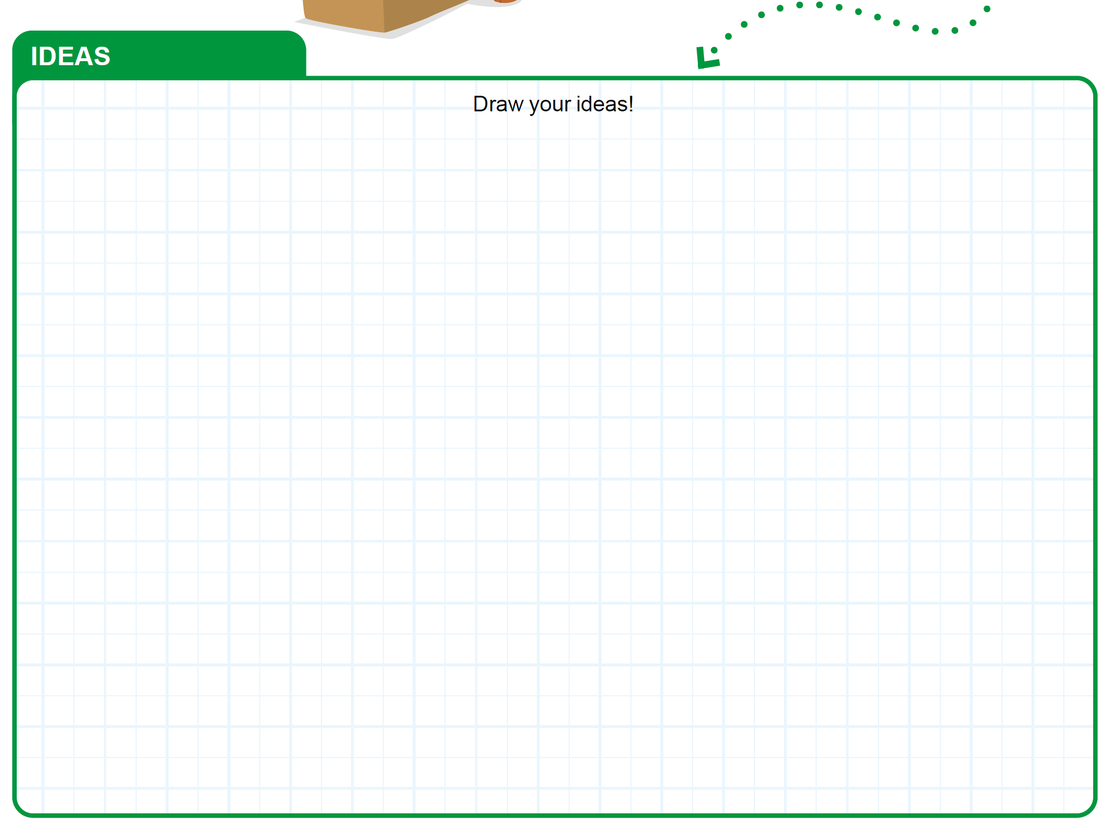
Task 2
How is blue cargo sorted into the blue bin on the sorting center? Brainstorm your ideas.
Say what you would change in the program in the space below.
Play your program to sort the blue cargo.
Notes:
Tasks (20 minutes)
Follow the building instructions in Book 2 to make the motor and hub build.
Connect the motor and hub build to the sorting center.
Open the WeDo 2.0 app.
Re-create the program provided in Book 2. Try it out!
How is blue cargo sorted into the blue bin on the sorting center? Brainstorm your ideas.
Say what you would change in the program in the space below.
Play your program to sort the blue cargo.

Slide 10

Share
Share what you did in the session.
Explain what products are in the cargo containers.
Show how you motorized the sorting center.
Demonstrate how you changed your code to sort the blue cargo.
Talk as a team about how a warehouse worker ensures cargo is sorted correctly.
Notes:
Share (10 minutes)
Have the team:
Share what they did in the session.
Explain what products are in the cargo containers.
Show how they motorized the sorting center.
Demonstrate how they changed the code to sort the blue cargo.

Slide 11
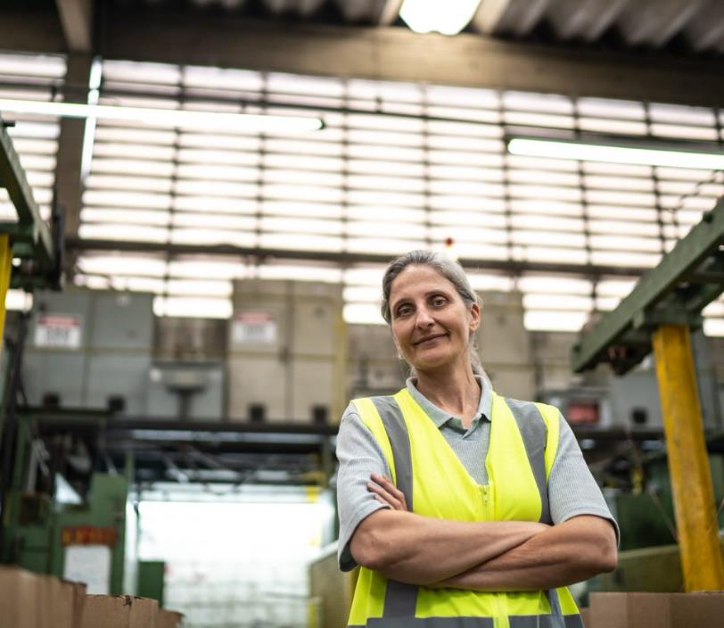
Career Connections
Warehouse Worker
Role:
Sorts products and places into boxes for shipping.
Notes:
Ask the children to reflect on what products they might like to sort and package as a warehouse worker.

Slide 12

Optional Video:
You may wish to embed a relevant, age-appropriate video for your students here. See the Notes for an example.
Notes:
Choose a relevant, age-appropriate video for your students.
Here is one example from 7News Australia about Inside Australia Post’s High Tech Parcel Soring Facility: https://youtu.be/XW_ka8Yu68U

Slide 13

Clean Up
Notes:
You may wish to play a video or song during clean up time Link on GoNoodle: https://family.gonoodle.com/activities/clean-up. Link on YouTube Kids: https://www.youtubekids.com/watch?v=ZJFk87ZsHn0 . Link on Youtube: https://youtu.be/ZJFk87ZsHn0
Cleanup Pointers
• The motorized sorting center should stay assembled, but everything else should be taken apart.
• Check that any unused pieces from the LEGO® set are returned to it.

Slide 14
FIRST® and the FIRST® logo are registered trademarks of For Inspiration and Recognition of Science and Technology (FIRST). LEGO® is a registered trademark of the LEGO Group. FIRST® LEGO® League and CARGO CONNECTSM are jointly held trademarks of FIRST and the LEGO Group. All other trademarks are the property of their respective owners. ©2021 FIRST and the LEGO Group. All rights reserved.

